Slide 1
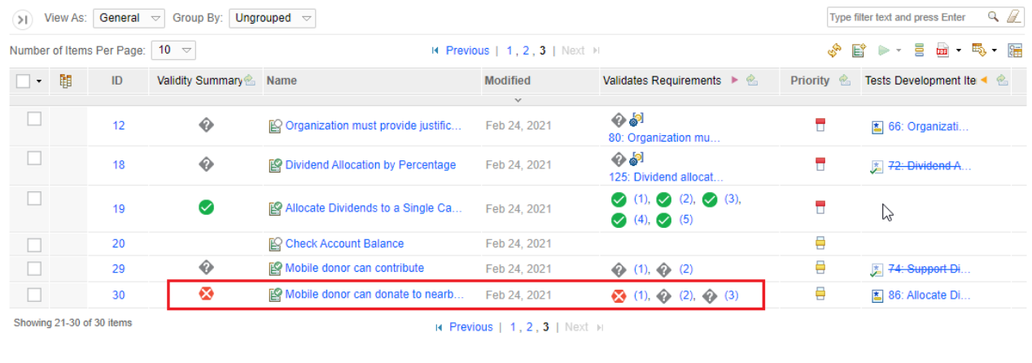
OSLC Specification for link validity
Eran Gery

Slide 2
Why standardizing link validity
“Linked data is only useful when semantic consistency exists between two artifacts and their relationship. In projects with large data sets, achieving and maintaining consistency across linked data can be challenging over time. You can use the link validity status to achieve consistency across artifacts and links as you make changes that propagate through linked data.” (IBM Jazz online documentation)
Currently OSLC does not provide any specification on how to establish and inquire validity of links

Slide 3
Key principles
A validity status of a link across two resources is defined in relation to the relevant contents of the resources.
Irrespective of resource versions!
Status can be “valid”, “invalid”, “suspect”
The validity status records are kept in a dedicated store owned by validity service
The validity records are added/updated only when a user explicitly sets a validity status
Change in resource contents does not trigger validity record update
In case of no content match the status is assumed to be “suspect”
The resources content is represented by a “content hash”
Validity records may be qualified using a “profile” identifier, to enable disjoint sets of validity settings across the same resources
E.g. two projects may consider different statuses for the same pair of resource contents

Slide 4
How link validity works
Link validity is specified wrt the source and target artifact contents represented by a content hash (#)
A link is identified by source#, target#, and linktype and the conceptURIs which are used for diagnostics and migration purposes and safeguarding uniqnes of the validity record
The artifact content hash is determined by the resource provider and can be based on a validity profile
RM Provider
RM Resource
ValidityStatus GetStatus (R1URI, R1#, R2URI, R2#, Linktype, profile)*
-> (R1URI, R2URI, Linktype, profile, ValidityStaus , comment, UID, time)*
RxURI is a concept URI
LVS returns the record with latest timestamp in
Case of multiple matches
Get should match R1,R2 or R2,R1 (order independent)
Get status is a bulk operation implemented using a post
3. GetContentHash(context, RsURI) -> contentHash
Link Validity Service
GetContentHash is a get on a
Concept resource with a special header
2. SetStatus (R1URI, R1#, R2URI, R2#, Linktype, ValidityStaus, profile, comment, UID, time)
-> success (200)/ (400)
Link Validity logical data model
verifies
Resource 1 # | Resource 2 # | Link Type URI | LinkValidity Profile | Validity Status
Valid, invalid, suspect
QM Resource
QM Provider

Slide 5
Link validity reporting
TRS feeds
Domain Providers
Concept URI | Concept URI | Link type
Domain version resources content hashes to be fed to TRS
Should be the responsibility of the domain providers (e.g. DNG) to feed the mapping to TRS
LVS TRS feed
Reporting on LV status is based on on conjuncting version URIs with content hash mappings and then with LVS feed
Example from ELM of finding the content hash (provided by Ernest)
?oslc_rm_Requirement1_contentHashVersion dcterms:isVersionOf ?oslc_rm_Requirement1_uri. ?oslc_rm_Requirement1_contentHashVersion ns_validity_:contentHash ?oslc_rm_Requirement1_contentHash.
Concept URI | Version URI
Version URI | Content#
LVS
Content# 1 | R1URI | Content# 2 | R2URI | Profile | Status

Slide 6
Link validity migration
How to recover LVS data after migration?
Content hashes will change
Need to map old content hashes to new content hashes
Migration should produce mapping tables
old URIs to New Uris (as part of link resolutions)
URI, old content#, new content #
LVS table should be corrected where oldURI, oldContent# entries are replaced with newURI, newContent#
This assumes URIs are in LVS
Probably requires storing version URIs in LVS

Slide 7
Comments on LVS related services
1 – get status: should allow a bulk operation for multiple links
2 – set status: a bulk operation necessary here? Probably not
3 – get hash: bulk may be useful but unclear on how to implement without pathmath

Slide 8
Issues with ELM current implementation
For some reason provide version URIs when interacting with LVS, that seems odd and unnecessary
Apply pathmath to obtain the hash from the resource provider
Instead should have a special header on the get of the resource

Slide 9
Link validity considerations
Relationship between LDM and link validity service (LVS)
Interaction patterns
Applications exchanging resource hash vs. LVS inquires resource hashes based on GCM

